Slide 1
Are health care cost barriers associated with flu vaccination? An analysis of older adults in Greater Boston, Massachusetts
Laura McNulty
Advanced Data Analysis Final Project
April 29, 2020

Slide 2
Overview
Background
Objectives
Methods
Results
Discussion

Slide 3
background: Seasonal flu in the U.S.
23,600 deaths
adults older than 65 years account for
200,000 hospitalizations
adults older than 65 years
account for
90%
63%
45%
vaccination rate
among older adults

Slide 4
Vaccination intention & uptake
Perceived susceptibility to flu
Perceived severity of flu
Trust in vaccine safety & efficacy
Concern with side effects
Influence of social networks
Cost and access barriers

Slide 5
objectives
Determine whether cost barriers to health care are associated with getting a flu vaccine.
Determine whether race modifies the association between health care cost barriers and flu vaccination.
Determine whether sex modifies the association between health care cost barriers and flu vaccination.

Slide 6
Methods

Slide 7
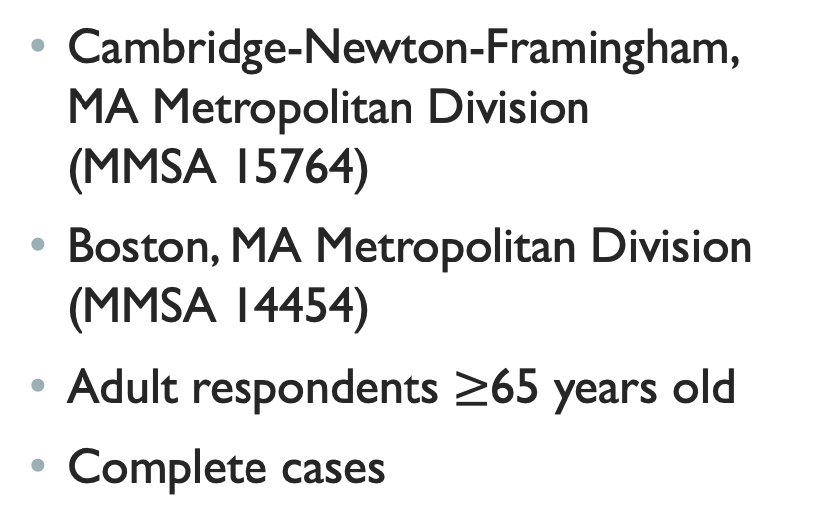
Study Population
Inclusion criteria
2017 Behavioral Risk Factor Surveillance System (BRFSS)
Selected Metropolitan/Micropolitan Area Risk Trends (SMART) data set
Cambridge-Newton-Framingham, MA Metropolitan Division (MMSA 15764)
Boston, MA Metropolitan Division (MMSA 14454)
Adult respondents $≥$65 years old
Complete cases

Slide 8
Variables of Interest
Independent (exposure)
Health care cost barrier
In the last 12 months, needed to see a health care provider but did not due to cost
Binary (no/yes)
Covariates
Age group
Factor, 4 levels (65-69, 70-74, 75-79, 80+)
General health
Factor, 5 levels (Poor → Excellent)
Sex
Binary (female/male)
Race/ethnicity
Factor, 4 levels (White non-Hispanic, Black non-Hispanic, Other or Multiracial, Hispanic)
Dependent (outcome)
Flu vaccine
Received a flu vaccination in the last 12 months
Binary (no/yes)

Slide 9
Directed acyclic diagram (DAG)
Sex
Race/ethnicity
Health care cost barrier
Flu vaccine
Age group
General health

Slide 10
Statistical analysis
Sample descriptive statistics
Logistic regression:
Model 1: Unadjusted
Model 2: Partially adjusted (age + general health)
Model 3: Fully adjusted with race/ethnicity as interaction term
Model 4: Fully adjusted with sex as interaction term
Test assumptions, influential values, model fit
R version 3.6.2

Slide 11
Results

Slide 12
Table 1. Characteristics of study population
Almost two-thirds of respondents (806, or 63%) received a flu vaccine in the last year
Most respondents (95%) reported no health care cost barrier
Nearly one-third (32%) were 65-69 years old
Nearly two-thirds (65%) described their health as good or very good
Most respondents (89%) were White non-Hispanic
Females comprised 58% of the sample

Slide 13
Table 2. Logistic Regression Results
* p < .05
ª Unadjusted
^{b} Adjusted for age group and general health
^{c} Includes race and interaction of race x health care cost barrier
^{d} Includes sex and interaction of sex x health care cost barrier

Slide 14
Discussion

Slide 15
Main Findings
No significant relationship between health care cost barriers and the odds of receiving a flu vaccine among older adults, after adjusting for age and general health (aOR = 1.15, 95% CI 0.67-1.95).
Neither race nor sex significantly modified the effect of health care cost barriers on flu vaccination.
In adjusted models, the odds of receiving a flu vaccine were significantly greater among Black adults compared to White adults (aOR = 1.99, 95% CI 1.15-3.42) and marginally lower among males compared to females (aOR = 0.84, 95% CI 0.66-1.06).

Slide 16
Strengths & Limitations
Complex survey sampling design yields a representative sample
No other study specific to Greater Boston area
Cross-sectional survey precludes establishing temporality
Predominantly white population and lack of health care barriers reduces analytic power for research questions of interest with this sample size

Slide 17
Conclusions & future Directions
To promote uptake of the flu vaccine in Greater Boston, it may be important to explore factors outside of health care cost barriers
Future research could investigate health belief model constructs to identify factors influencing vaccine uptake
Consider over-sampling non-White adults to increase power to detect differences by race/ethnicity

Slide 18
References
2017 SMART BRFSS MMSA Data (SAS Transport Format). https://www.cdc.gov/brfss/smart/smart_2017.html. Published October 2018. Accessed March 23, 2020.
2017 SMART BRFSS MMSA Methodology. Centers for Disease Control and Prevention. https://www.cdc.gov/brfss/annual_data/2017/pdf/2017_SMART_BRFSS_MMSA_Methodology-508.pdf.
Benjamin SM, Bahr KO. Barriers Associated with Seasonal Influenza Vaccination among College Students. Influenza Research & Treatment. March 2016:1-5.
Chen JY, Fox SA, Cantrell CH, Stockdale SE, Kagawa-Singer M. Health Disparities and Prevention: Racial/Ethnic Barriers To Flu Vaccinations. Journal of Community Health. 2007;32(1):5-20.
Cheung K, Ho SMS, Lam W. Factors affecting the willingness of nursing students to receive annual seasonal influenza vaccination: A large-scale cross-sectional study. Vaccine. 2017;35(11):1482-1487.
Cohen B, Ferng Y-H, Wong-Mcloughlin J, Jia H, Morse SS, Larson EL. Predictors of flu vaccination among urban Hispanic children and adults. Journal of Epidemiology and Community Health. 2010;66(3):204-209. doi:10.1136/jech.2009.099879
Disease Burden of Influenza. Centers for Disease Control and Prevention. https://www.cdc.gov/flu/about/burden/index.html. Published January 10, 2019. Accessed March 23, 2020.
Flu Vaccination Coverage, United States, 2016-17 Influenza Season. Centers for Disease Control and Prevention. https://www.cdc.gov/flu/fluvaxview/coverage-1617estimates.htm. Published September 28, 2017. Accessed March 23, 2020
Gu Q, Sood N. Do People Taking Flu Vaccines Need Them the Most? PLoS ONE. 2011;6(12). doi:10.1371/journal.pone.0026347
Harrison N, Poeppl W, Miksch M, et al. Predictors for influenza vaccine acceptance among patients with inflammatory rheumatic diseases. Vaccine. 2018;36(32):4875-4879. doi:10.1016/j.vaccine.2018.06.065
Influenza. Centers for Disease Control and Prevention. https://www.cdc.gov/vaccines/pubs/pinkbook/flu.html#impact. Published April 15, 2019. Accessed March 23, 2020.
Madhavan SS, Borker RD, Fernandes AW, Amonkar MM, Rosenbluth SA. Assessing Predictors of Influenza and Pneumonia Vaccination in Rural Senior Adults. Journal of Health & Social Policy. 2003;18(2):71-93. doi:10.1300/j045v18n02_05
Ratnapradipa KL, Norrenberns R, Turner JA, Kunerth A. Freshman Flu Vaccination Behavior and Intention During a Nonpandemic Season. Health Promotion Practice. 2017;18(5):662-671.
Yang ZJ. Predicting Young Adults’ Intentions to Get the H1N1 Vaccine: An Integrated Model. Journal of Health Communication. 2015;20(1):69-79.
Yeung MPS, Lam FL, Coker R. Factors associated with the uptake of seasonal influenza vaccination in adults: a systematic review. Journal of Public Health. June 2016. doi:10.1093/pubmed/fdv194

